Slide 1
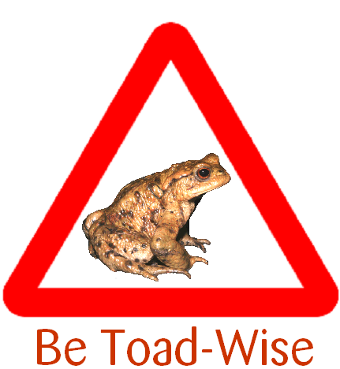
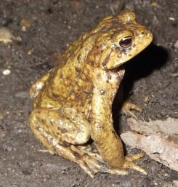
Carpe Bufo?
Initial results of the TOADSIZE study 2013
An ARC + ARG UK joint project
Dr. John W. Wilkinson, ARC
& Dr. Angela Julian, ARGUK

Slide 2
Introduction
Several observers have reported (anecdotally) populations of toads where all adults are very small.
Is this because traffic mortality prevents them from growing to full size?
TOADSIZE 2013 was initiated to investigate…!

Slide 3
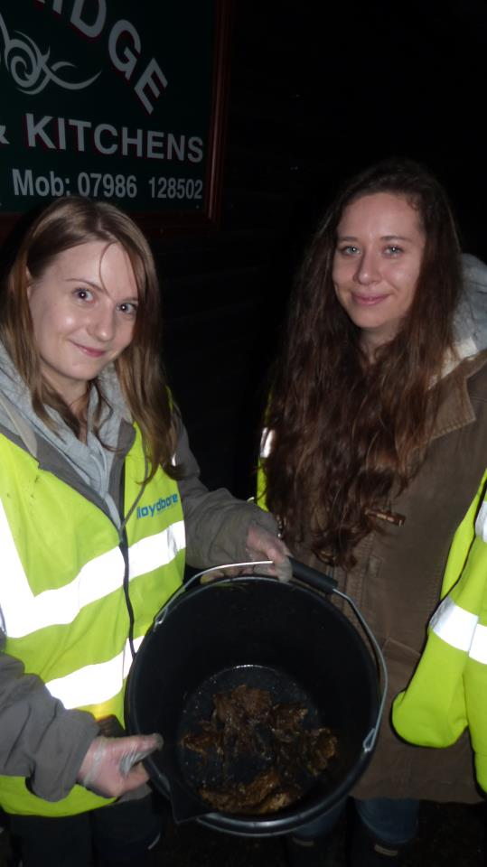
Toad Patrols
Toad patrols occur each spring around the UK – many depend on ARG volunteers.
Volunteers gather toads in buckets, and carry them over roads and, where possible, on to their breeding ponds.
Photo copyright Amy Wright, KRAG

Slide 4
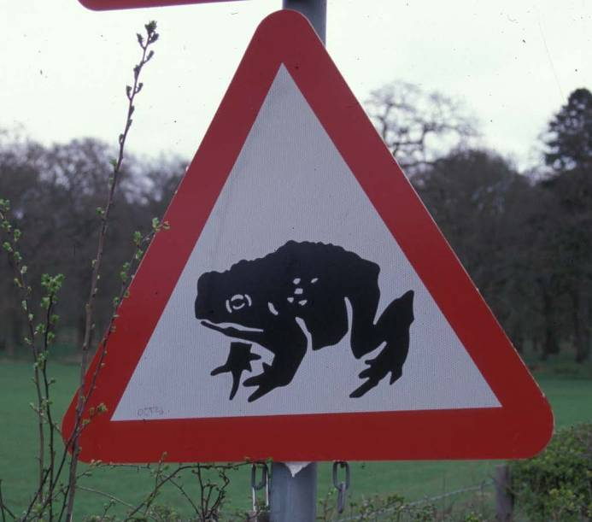
Toad Patrols
Net effect of toad patrolling?
Fewer toads are killed by traffic whilst migrating to their breeding ponds.
But what is the overall effect on toad populations?

Slide 5
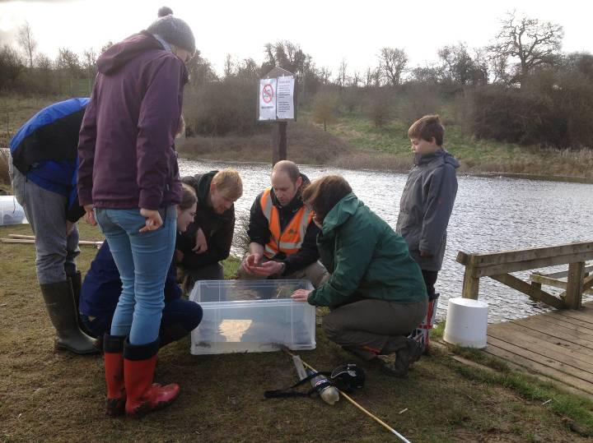
Citizen Science
We asked the ARGs and Toad Patrols to help us gather data.
This enabled us to cover a large geographic spread, and compare the impact of different variables including: type of road, toad patrol, and location of the breeding pond.

Slide 6
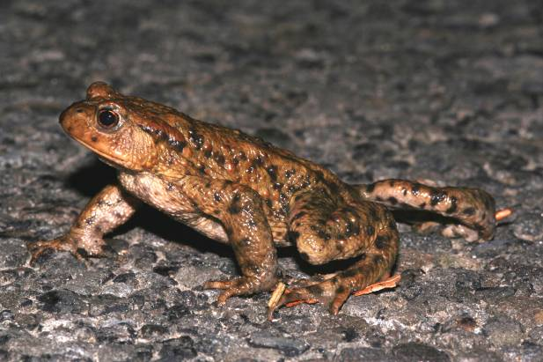
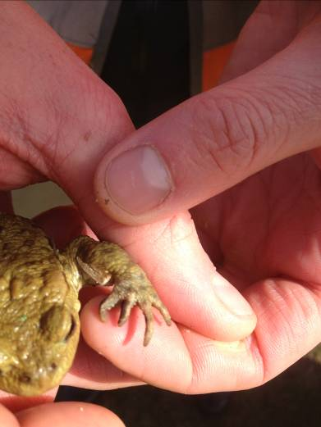
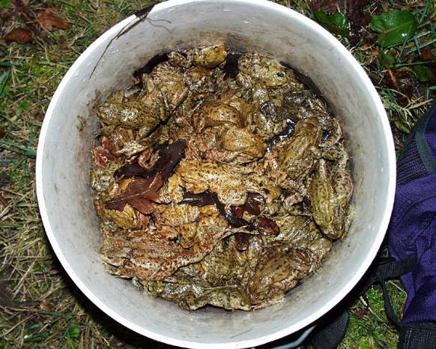
Methodology: identify male toads
Look for nuptial pads, males also have a distinctive ‘cheeping’ release call

Slide 7
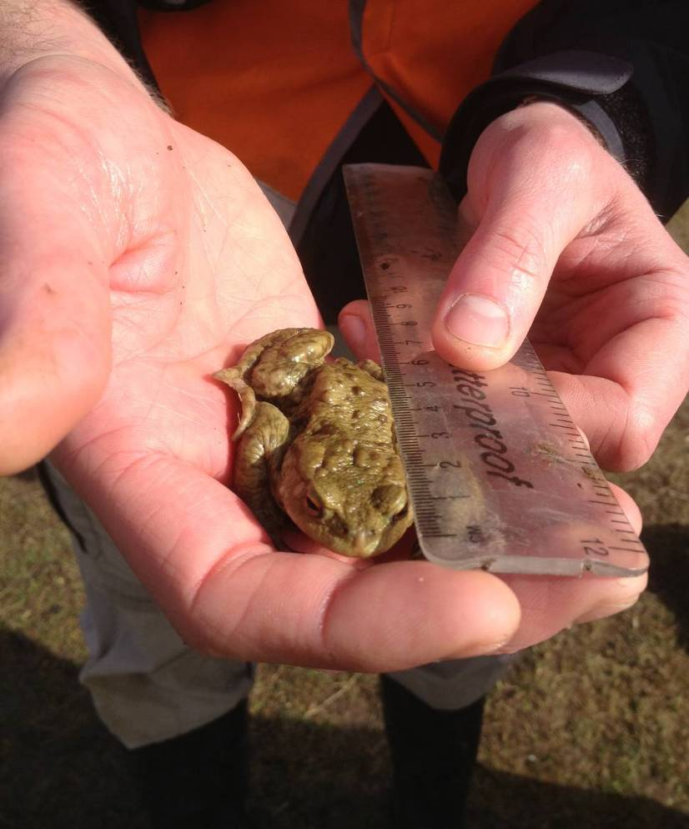
Methodology: toad measuring

Slide 8
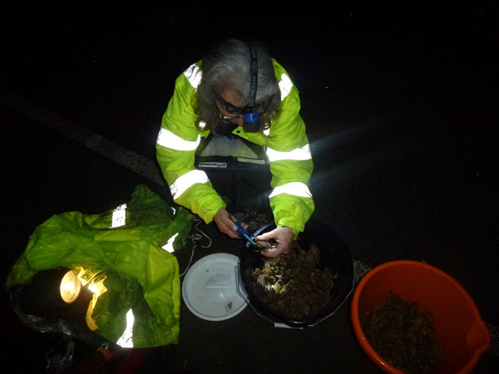
Methodology: toad measuring (in practice)

Slide 9
Methods: data collection
Toad patrollers were asked to record:
  Name/location details
  Date/s of patrols
  Type of road (0 – 3)
  Level of traffic (0 – 3)
  Tunnel present?
  Patrol frequency (0 – 3)
  Distance of crossing from breeding pond
  Sizes (in mm) of MALE toads – ideally 10-20 individuals per night on up to 10 crossing nights

Slide 10
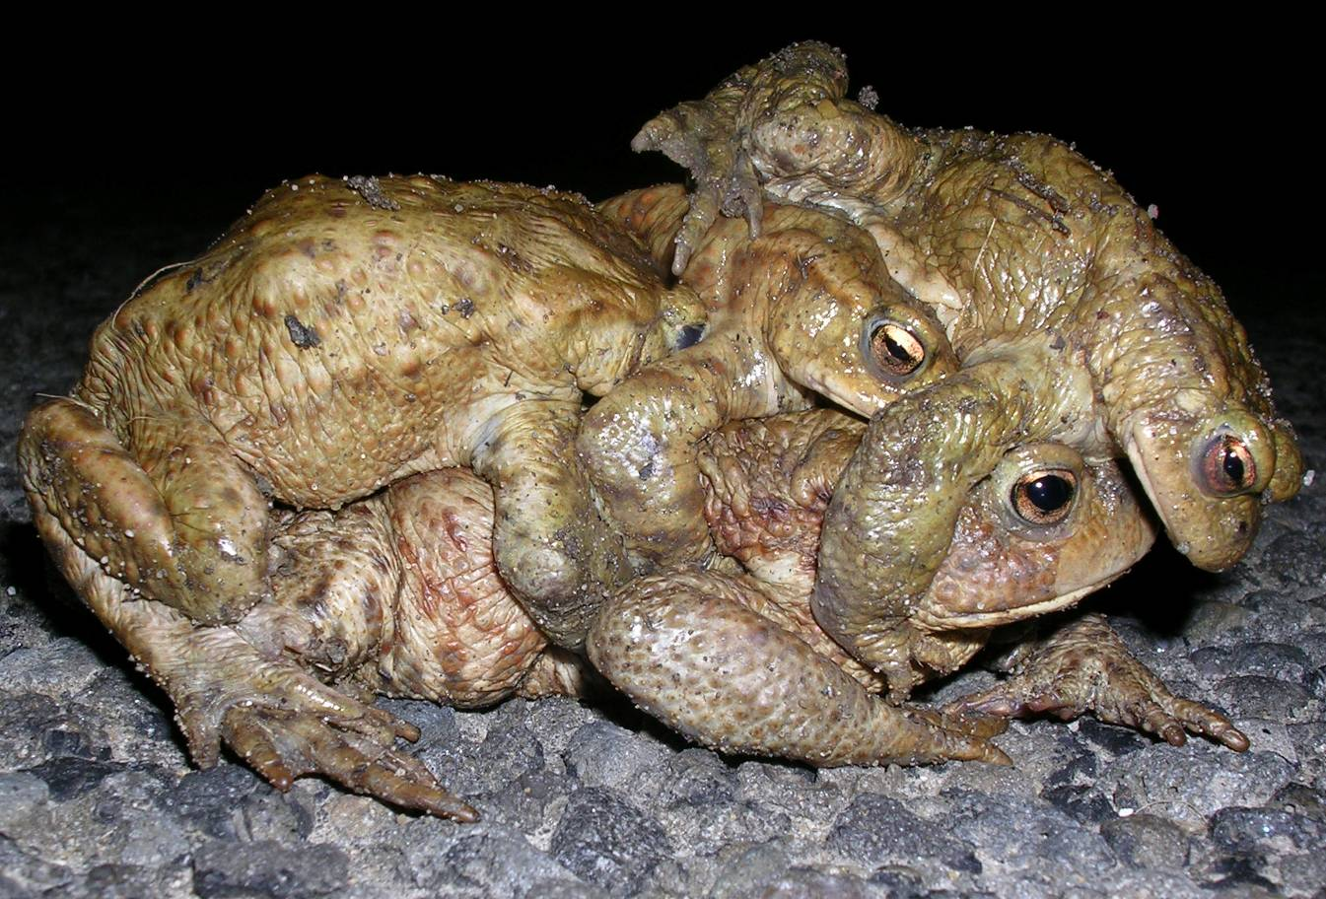
Results

Slide 11
Results
Were received from 19 crossings in 2013
750 toads were measured!
Results were collated in Excel spreadsheets and analysed using ‘R’ statistical software
Toad sizes were NOT normally distributed so data was normalized for parametric analysis (provides more options for analysis)
[due to finite size of toads!]

Slide 13
Results
There was no difference in toad sizes between sites with/without traffic (ANOVA; p=0.48)
There was no difference in toad sizes between sites with/without patrols (ANOVA; p=0.48)
But, looking at all factors together using ANOVA:
Factor | F value | p | Sig?
SITE | 0.516 | 0.4729 | no
DAY OF PATROL | 3.58 | 0.0589 | no
ROAD CATEGORY | 0.738 | 0.3905 | no
TUNNEL Y/N | 0.369 | 0.5439 | no
TRAFFIC DENSITY | 0.635 | 0.4257 | no
PATROL FREQUENCY | 31.793 | <0.0001 | HIGHLY
DISTANCE FROM POND | 32.826 | <0.0001 | HIGHLY

Slide 14
Results: PATROLS

Slide 15
Results: DISTANCE FROM POND

Slide 16
Results
Tentatively….
Toads at breeding sites WITH more frequent patrols have a greater size-range
The average size of toads is larger at breeding sites where the crossing/road is further away from the pond, BUT the smallest toads occur at sites where the crossing is 100 – 200m from the pond

Slide 17
Conclusions
Also tentatively….
The greater size-range observed where patrols were more frequent may equate to a better (i.e. broader range) age structure, resulting from reduced (small) toad mortality.
Smaller toads appear to fare better where crossings are nearer the pond, which may reflect the greater risks to smaller animals of travelling over longer distances (in terms of risk of predation, exhaustion, or just less able to compete with larger toads).

Slide 18
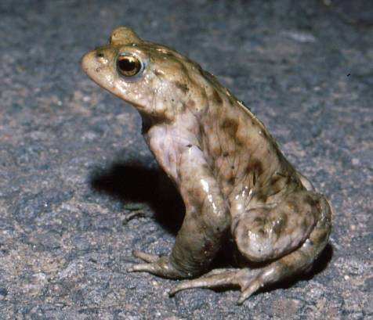
Moving on in 2014….
We need to repeat the survey over a number of years, and at additional sites to test these findings further, to find out what the relationship between toads and roads and the impact of toad patrolling is
We need your help to do this!!
More details and Toadsize forms on the ARGUK web-site
www.arguk.org

